Slide 1

Hubli Route Division (government Dataset)
Source: https://www.data.gov.in/ Dataset: Hubli Route Division Details Email: saikoushik510@gmail.com LinkedIn: https://www.linkedin.com/in/koushik-madisetty-6525972aa/

Slide 2
Introduction:
The presentation provides an analysis of the Hubli Route Division Dataset covering:
- Route length & Types
- Frequent Visited Destinations
- Variation And Clustering Patterns
- Key Insights and Conclusion

Slide 3
DATASET Description:
The "Hubli Division Route Details" data set has 360 entries, each corresponding to a transport route in the Hubli division. It contains four important attributes: Serial Number (Sl no), From, To, and Route Length, specifying the source and destination points and the corresponding distances in kilometers.
All routes are from Hubballi (Hubli) and go to other towns, cities, and villages. The ROUTE Length column emphasizes different lengths, from short routes such as Hubballi to Aralikatti (20 km) to longer ones such as Hubballi to Belgam (100 km). The data is complete with no missing values, hence suitable for analysis.
This information can be applied to transportation planning, logistics, and infrastructure development, enabling the optimization of travel paths and network connectivity. If you would like additional analysis or visualizations, please let me know!

Slide 4
Initial dataset Analysis:
- Loaded dataset and checked for missing values
- Converted necessary columns to appropriate data types
- Identified unique stations, routes, and patterns

Slide 5
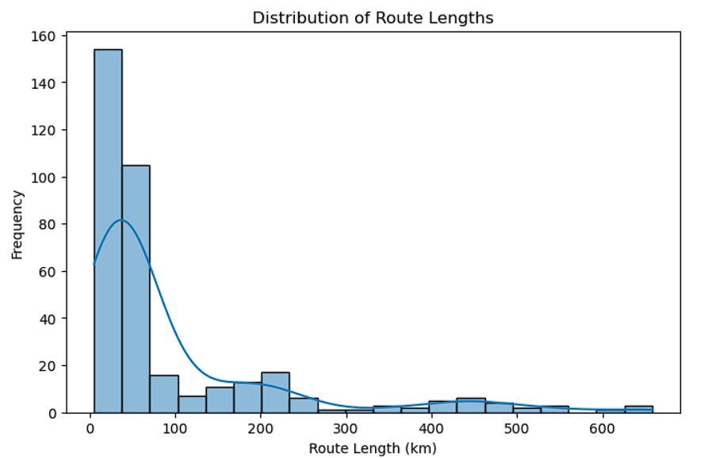
Showing the route length across the dataset
This shows the Route length across the various kilometers (km) travelled

Slide 6
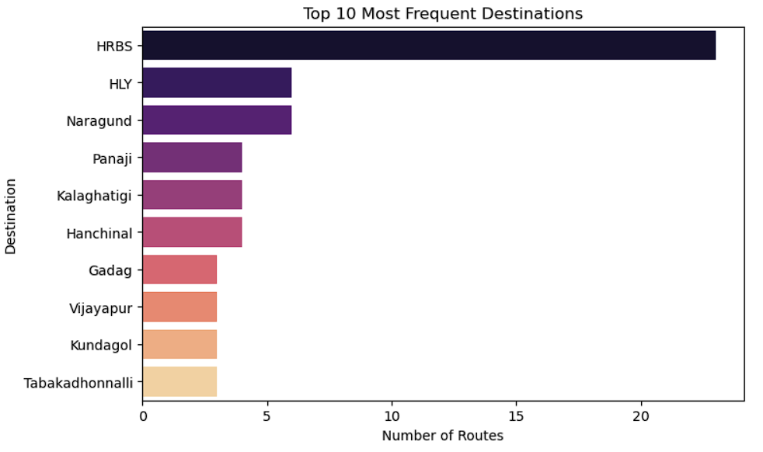
Top 10 Most Frequent Destinations
This barplot shows the top 10 most frequent destination visited from the hubbali

Slide 7
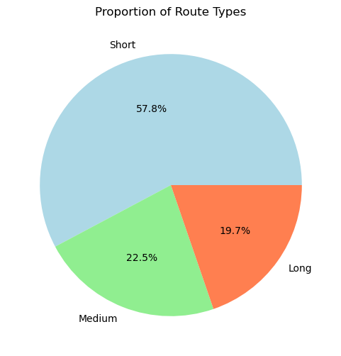
The percentage distribution of short, medium, and long routes
This pie chart describes that how much percentage of the distance is travelling

Slide 8
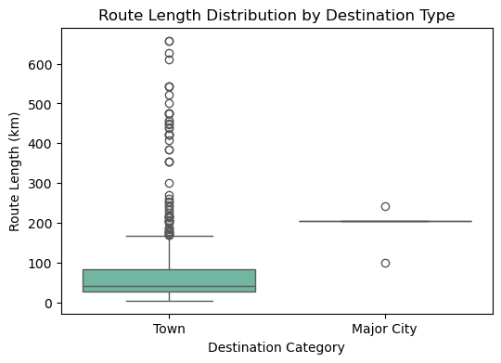
Route length distribution by destination type
The box plot describes the route length distributed by destination type

Slide 9
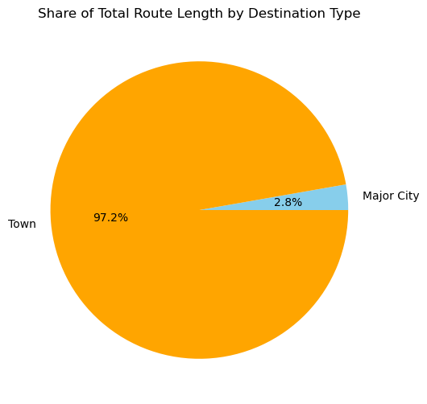
Share of total Route length by Destination Type
The pie chart describes the 97.2% travels & covering the town and 2.8% is travels the major city

Slide 10
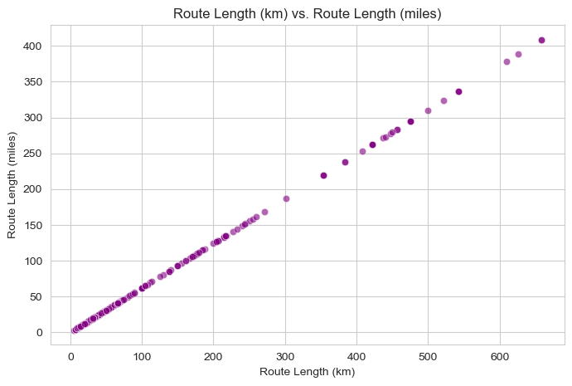
Route length (KM) vs Route length (Miles)
The scatter plot describes the route length in km vs route length in miles how it was going through

Slide 11
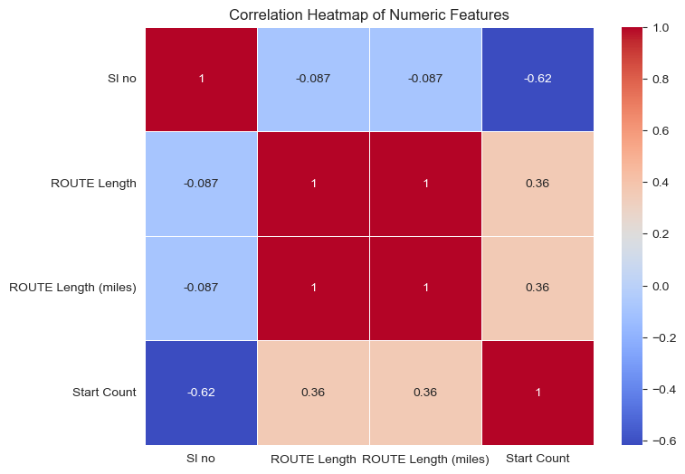
Correlation Heatmap of Numeric Features
This Heatmap shows that the correlation between the all factors that how they are interlinked.

Slide 12
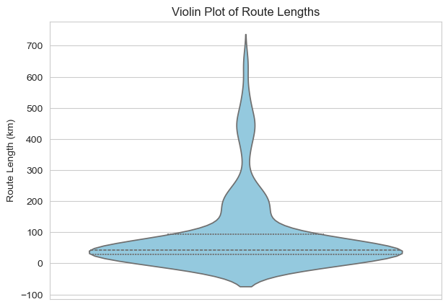
Route lengths in the KM
The Voilin plot describes the Route length how it was varying

Slide 13
DATASET OBSERVATIONS:
Dealing with Missing Values: Missing route distances were filled with the median value to avoid skewing the data.
Checking Data Types and Converting Units: We ensured numbers were correctly formatted and added a "Miles" column (1 km ≈ 0.62 miles) for better analysis.
Removing Duplicates and Identifying Outliers: Duplicates were removed, and outliers in route lengths were detected using a box plot.
Categorizing Routes Routes were grouped into:
Short (<50 km)
Medium (50–150 km)
Long (>150 km) This helped reveal travel patterns.

Slide 14
DATASET OBSERVATIONS:
Adding Useful Features
Start Count: Frequency of a location as a starting point.
Moving Average: Smoothed out distance trends.
Insights from Visuals
Bar Plot: Hubli had the most routes and highest total distance.
Box Plot: Some locations had extreme route lengths.
Line Plot: Route distances fluctuated but showed trends.
Scatter Plot: More routes didn’t always mean longer distances.
Pie Chart: A few locations covered most of the total distance.

